Slide 1
CSC3001 Discrete Mathematics Tutorial 0
Li Jingyu

Slide 2
About myself
Li Jingyu （李璟瑜）
Year 3，Computer Science, SDS
Email: 118010141@link.cuhk.edu.cn
Office Hour: Friday 16:00-17:00
LG103, Start-up zone library (temporal)
Previous: MAT1001 USTF

Slide 3
About the course
What does “discrete” mean?
Countable, distinct, separable…
What we are going to learn?
Logic, proof, recursion, gcd, graph, counting…
What’s the style of this course?
Interesting…

Slide 4
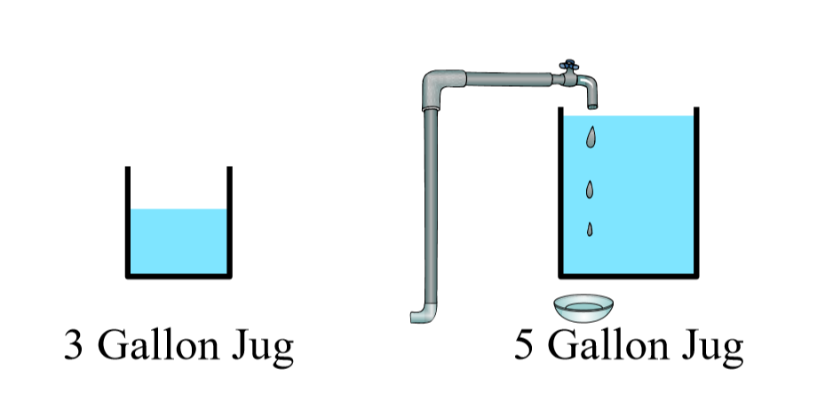

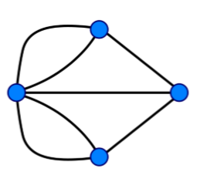

Some examples

Slide 5

About the tutorials
Practice questions
Zoom: 251 184 7965
Handwriting

Slide 6
My experience
Practice more!
Summarize the techniques in your own way
Review the lecture notes
Prepare for the exam…

